Slide 1



Welcome to FAO
The Food and Agriculture Organization of the United Nations
GUINEA ECUATORIAL
OPIM IMPLMENTATION
LESSONS LEARNED

Slide 2

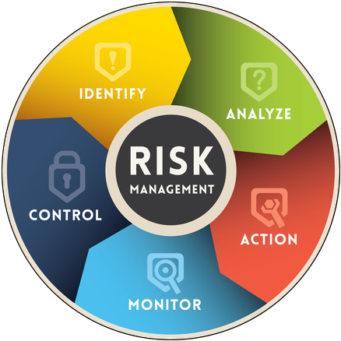

GUINEA ECUATORIAL
WHY OPIM
Pour répondre à la demande croissante de mise en œuvre de projets en collaboration avec des acteurs nationaux et non lucratifs, l'objectif est de tirer parti de l'expertise locale, de renforcer les capacités nationales, de consolider l'appropriation nationale et, à terme, d'obtenir des résultats plus durables sur le terrain.
BUREAU DE PAYS DE LA
FAO - OPIM
Mesures de responsabilisation

Slide 3
GUINEA ECUATORIAL
The key challenges faced by FAO country offices in implementing the Operational Partner Implementation Modality (OPIM) under GEF
Coordination and Partnership Management: Identifying effective collaboration mechanism with operational partners
Capacity Constraints: Understanding of differentiated procedures, rules and regulations applied by involved entities
Funding and Financial Management: Challenges in disbursing funds efficiently, managing budgets, and maintaining financial accountability.
Monitoring and Evaluation: Difficulties in establishing robust M&E systems
Alignment with Local Contexts. Flexibility to adjust to changing environment
Risk Management: Qualified experts : Identifying, mitigating, and managing risks related to transparency, abuse of funds, and project delays.
Communication and Reporting: Experts, mechanism and methods for consistent, transparent, and timely communication and reporting among all stakeholders to meet GEF and FAO standards.
Sustainability and Ownership: Long-term sustainability and national ownership of project activities.
Regulatory and Administrative Barriers: Navigating complex regulatory environments, legal requirements, and administrative procedures which may delay or complicate implementation.
Resource Mobilization: Securing ongoing financial and technical resources to sustain project activities beyond initial phases.
These challenges require targeted strategies including capacity building, strengthened coordination mechanisms, clear contractual arrangements, and robust monitoring systems to enhance the effectiveness of OPIM in GEF projects.
Regenerate

Slide 4
GUINEA ECUATORIAL
Les principaux défis rencontrés par les bureaux de pays de la FAO dans la mise en œuvre du mécanisme de mise en œuvre par les partenaires opérationnels (MPPO) des projets du FEM
Financement et gestion financière
Coordination et
gestion des
partenariats :
Obstacles réglementaires et administratifs :
CONTRAINTES EN MATIÈRE DE CAPACITÉS
Pérennité et appropriation
Communication et rapports
Adaptation aux contextes locaux
Suivi et évaluation

Slide 5
GUINEA ECUATORIAL
LEÇON APPRISE
Examen des capacités et des lacunes
Continuité
Préparation préalable
(Équipe de projet, installations de soutien opérationnel)
Début de la mise en œuvre
TRANSFERT
FAO
OP
FAO
OP
Local G & B
FAO
Admin & Financial Management Support

