Slide 1

Overview of the
Green Climate Fund (GCF)

Slide 2


What is the Green Climate Fund (GCF)?
Funding Proposal (FP)
Climate investment projects targeting Adaptation & Mitigation
Various financial instruments (grant, loans, etc.)
336 projects approved globally (USD 19.3 billion committed)
Readiness programme
Updated Readiness Strategy 2024-2027
Country window: up to USD 7 million
Enhancing capacities
Formulating strategies
Planning climate programming
Fostering knowledge-sharing

Slide 3
GCF – key stakeholders
National Designated Authority (NDA): government institution acting as an interface between each country and the GCF.
Accredited Entity (AE): receives funds from the GCF for Funding Proposals. Overall responsibility for project formulation and implementation.
158 AEs: 34% international AEs & 66% Direct Access Entities (regional and national)
Executing Entity (EE): entity responsible for implementing and achieving project results.
Implementing partner: provides services for the implementation of activities.
Delivery Partner (DP): Implement Readiness grants. Nominated by NDAs.

Slide 4
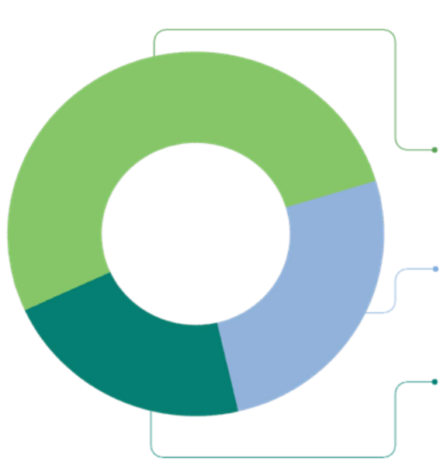

FAO’s GCF Portfolio (USD 1.8 billion)
29 Funding Proposals
114 Readiness
Projects by region:
RLC – 9
RAF – 9
RAP – 5
REU – 3
RNE – 3
USD 93.4
Million
52%
Cross-cutting
USD 1.7 billion
24%
Adaptation
8 Projects
where FAO is a partner
24%
USD 75 million
Mitigation

Slide 5
FAO-GCF portfolio in RAF – Funding Proposals
FP # | Country | Implementation period | Budget (GCF grant)
SAP015 | Cote d'Ivoire | 19 Feb 2021 – 18 Feb 2026 | 10 M
FP159 | Congo | 5 Nov 2021 – 5 Nov 2029 | 30 M
FP187 | Benin | 28 Dec 2022 – 28 Dec 2028 | 19 M
FP188 | The Gambia | 28 Oct 2022 – 28 Oct 2028 | 17 M
FP238 | Malawi | 23 Jul 2024 – 22 Jul 2030 | 43 M
FP246 | Somalia | 24 Oct 2024 – 23 Oct 2031 | 80 M
FP255 | Kenya | 20 Feb 2025 – 19 Feb 2031 | 29 M
FP268 | SURAGGWA (Burkina Faso, Chad, Djibouti, Mali, Mauritania, Niger, Nigeria, Senegal) | 3 Jul 2025 – 2 Jul 2035 | 150 M
FP280 | Uganda Results-Based Payment (RBP) | Approved in October 2025 | 31 M

Slide 6
FAO-GCF portfolio in SFC
Funding Proposal (FP)
Readiness programme
Congo– USD 28, 988,852 (GCF grant)
PREFOREST CONGO - Project to reduce greenhouse gas emissions from forests in five departments in the Republic of Congo
Country | Amount | Status
Equatorial Guinea | $300,000 | Fin closed
Congo, Republic of | $617,000 | Fin closed
Equatorial Guinea | $600,000 | Fin closed
Democratic Republic of Congo | $299,718 | Fin closed
Chad #1 | $359,903 | Fin closed
Cameroon | $250,000 | Fin closed
Equatorial Guinea#3 | $299,894 | Fin closed
Burundi | $299,999 | Fin closed
Sao Tome and Principe | $999,315 | Operational active
Global (Chad, Equatorial Guinea, Cuba, Mozambique, Mauritania, Zambia | $2,475,000 | Operational active
Gabon | $1,000,000 | Operational active
Chad #2 | $817,236 | Operational active
Chad – USD 14,896,385 (GCF grant)
Scaling-Up Resilience in Africa’s Great Green Wall (SURAGGWA)

Slide 7

GCF funding windows & project cycle

Slide 8
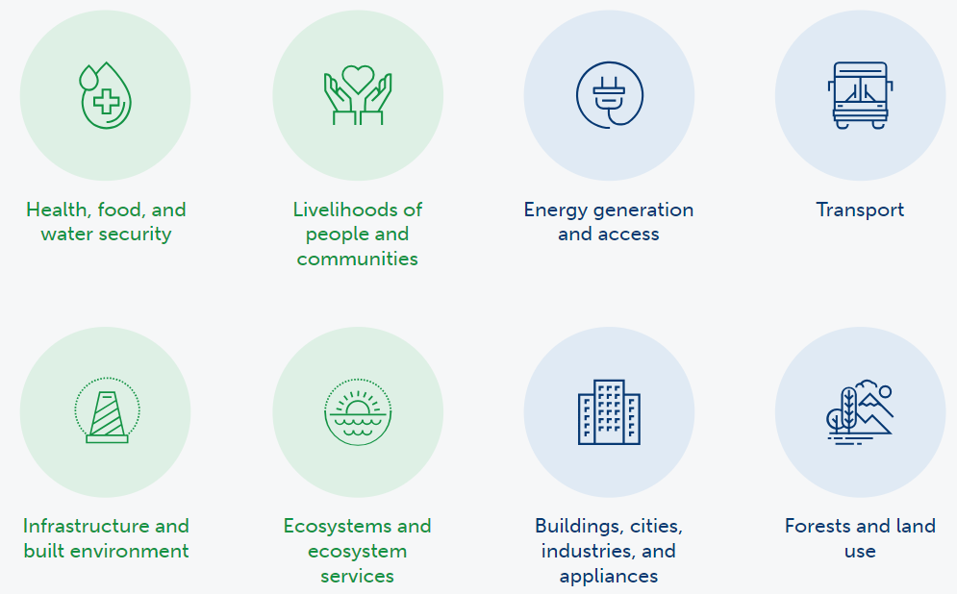
What does the GCF fund?
Funding Proposal
GCF Investment Criteria
Impact potential
Paradigm shift potential
Sustainable development potential
Needs of beneficiaries
Country ownership
Efficiency and effectiveness
Adaptation Result Areas (ARA)
Mitigation Result Areas (MRA)

Slide 9
GCF Readiness access modality for FAO
Readiness
Step 1
NDAs request for support to GCF & submit country outcome logframe and a signed nomination letter
Step 2
Readiness proposal formulation
Step 3
Submission of Readiness proposal & review
Step 4
Approval/Agreement between GCF and FAO
GCF direct access proposal template: here
Through the GCF Fluxx system. DPs will have access. GCF review will take 1-3 months.
N/A: FAO – GCF Readiness Framework Agreement.
An agreement between FAO and the Country will be needed.
Ensure Direct Access is marked/chosen!
FAO together with NDA to formulate the Direct Access proposal.

Slide 10
GCF Strategic Programming

Slide 11
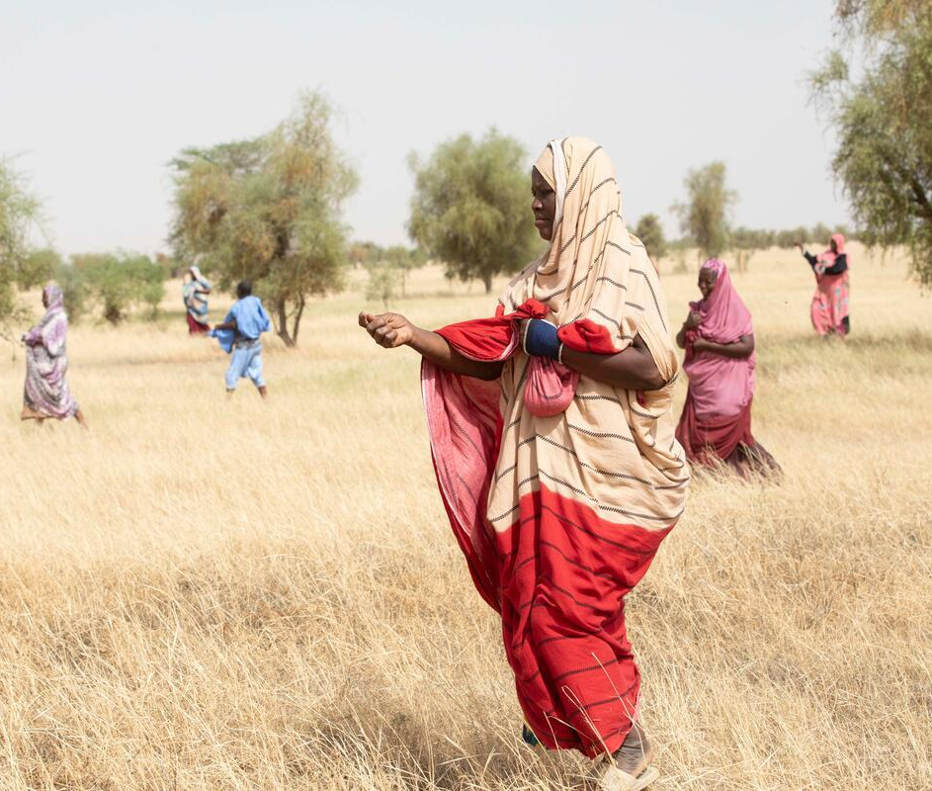
Key GCF priorities
Underserved countries
Country ownership
Increased access by Direct Access Entities (DAEs)
Continued efforts on adaptation
Results reporting
AE’s performance

Slide 12
GCF’s messages
AE implementation is increasingly scrutinized
Partial cancellations and/or withdrawals will be initiated by the GCF
Results reporting and communication is MUST
IAEs to support Direct Access Entities (DAEs)

Slide 13
FAO’s response to GCF’s new direction
Support countries/DAEs through new Readiness
Partnership with DAEs & other entities
Diversified funding mechanisms
High-quality proposals
Enhanced support/coordination on implementation
Results-based reporting & coordinated communication
Capacity development / Community of Practice

Slide 14
Overall GCF portfolio in the Central African region
Country | # FA | # single country FA | FA financing (USD) | # Readiness | Readiness (USD)
Burundi | 4 | 2 | 44.2 M | 6 | 4.5 M
Cameroon | 9 | 0 | 81.9 M | 5 | 3.8 M
CAR | 1 | 0 | 40 M | 7 | 2.8 M
Chad | 8 | 0 | 103.8 M | 12 | 5.4 M
Congo | 1 | 1 | 29 M | 5 | 2.3 M
DRC | 10 | 1 | 114.5 M | 10 | 3.7 M
Equatorial Guinea | 0 | 0 | 0 | 9 | 5.1 M
Gabon | 6 | 0 | 58.4 M | 7 | 3.3 M
Sao Tome and Principe | 1 | 0 | 17.4 M | 5 | 6 M
Direct Access Entities:
There is No national Entity
Regional: Sahara and Sahel Observatory (OSS)

Slide 15
GCF Readiness Programme 2024-2027
Readiness
Objective 1. Capacity-building for climate finance - 30%
NAP 1 allocation =
USD 3 million (if not used)
+
Readiness allocation = USD 4 million
Up to 7 million in total
Objective 2. Pipeline development and direct access- 60%
One or max two multi-year proposals
(Min size USD 1 million)
Objective 3. Knowledge-sharing 10%
After USD 7M is approved by GCF, an extra USD 3 million (NAP 2) is available per country for NAP implementation.
FAO’s comparative advantage
Readiness Framework Agreement holder since 2018​
Delivery Partner with the highest number of GCF Readiness grants approved​

Slide 16
Examples of activities where FAO can support NDAs
Readiness
Readiness as a programming tool for countries in accessing climate finance
Increased technical and coordination capacity (e.g. REDD+ national coordination structure established in West Africa’s countries)
Development of strategies (NDCs, NAP, etc.) to advance countries’ climate action (e.g. five Regional Adaptation Plans developed for Togo)
Improved country’s data management & monitoring
Support DAE’s accreditation process (e.g. Eswatini Development Bank)
Enhanced country programming (e.g. GCF Programmatic workshops organized in Djibouti and Madagascar, Country Programme for Burundi developed)
Support pipeline development (project ideas, CNs, and/or FPs)
Advancing REDD+ (e.g. submission of Sudan’s Forest Reference Level Report to UNFCCC)
Knowledge management & south-south exchange

Slide 17

GCF programming – how it works
Country engagement
Concept Note (CN)
Funding Proposal (FP)
GCF Board consideration
Identification of priority ideas (led by NDA)
GCF Sec – NDA discussion on overall country’s pipeline
Partnership building – DAEs
Agree on pipeline and AEs
CN development
Quality Assurance
GCF Sec review
FP development
Quality Assurance
GCF Sec review
→ iTAP
Approve or not
Three times per year
This process can happen only if both NDA and GCF agree to put the project idea in (hard) pipeline
Readiness Programme
Project Preparation Facility (PPF)*

Slide 18
Key questions to be answered
Is your country considered “underserved”?
Which are the top 2 priorities for the NDA?
Does the country have DAEs or entities under accreditation process?
Does FAO have a strong track record of performance in the proposed thematic area?
Different ways to respond to the government’s requests
Option 1 - FAO as AE
Option 2 – Identification of DAE as AE (FAO co-formulator and EE as a technical partner)
Option 3 – Identification of other resource partners (GEF or other bilateral/multilateral donors)

Slide 19






OCB-GCF team’s support
Formulation and implementation support
Development of guidance notes and annotated templates
Quality assurance/improvement
Funding Liaison role
Operations coordination and support
Support and contribute to the preparation of agreements
Capacity development and knowledge sharing
Liaison with GCF
Guidance documents and formats
Community of Practice
Customized capacity-building events
OCB & and inter-division collaboration
Outreach
Establishing partnerships
COP, NAP Expo, GCF regional dialogue, etc.
Fact sheets and testimonials
Direct access entities (DAE), GEF, private sector, RBA, IFIs, UN, etc.

Slide 20
Thank you

